Slide 1
HB 2017 Transit Advisory Committee
February 23, 2018
Notes:
Neil Introduction

Slide 2
Meeting Agenda
Welcome and Introductions 5 min.
Review & Approve Revised Guiding Statement 5 min.
Rulemaking Update & “High Percentage” Poverty 20 min.
Review & Approve FY19 Service Proposal 15 min.
Regional Coordination 30 min.
Public Comment 15 min.

Slide 3
Advisory Committee Guiding Statement
✓
HB 2017 provides much-needed investment in transit service. For the first time, employees in Oregon will be taxed to pay for transit, and low-income workers will contribute proportionately more of their incomes as a result. Annual per capita income in the Portland metropolitan areas is below the U.S. average and a lack of affordable housing has pushed low-income residents to areas with lower transit services. It is therefore critical that investment of this funding serve the needs of low-income people to have affordable, reliable, convenient transit service that connects them to jobs and services.​ A modern, well-funded transportation system that is planned, built, and operated with equity as a guiding principle will benefit everyone through reduced air toxics, carbon output, and congestion, and shape our region for generations to come. Therefore, the committee will advise TriMet on a public transportation improvement plan to spend HB2017 funds for the following purposes:
Expansion of existing and creation of new transit services (including last mile services), except for light rail, with consideration for communities with a high percentage of low-income households and responsible contracting and workforce utilization,
programs to reduce transit fares for communities with a high percentage of low-income households,
procurement of buses powered by natural gas or electricity,
capital projects required for the creation, expansion and improvement of transit services, including projects intended to improve speed and reliability, with consideration for communities with a high percentage of low-income households and responsible contracting and workforce utilization,
expansion of existing/creation of new transit services in communities outside the TriMet service district, but inside in Clackamas, Multnomah, and Washington counties, and
regional coordination/reduction of fragmentation between TriMet and communities outside the TriMet service district, but inside Clackamas, Multnomah, and Washington counties.

Slide 4
Rulemaking Update/High Percentage Poverty
Deadline extension
Poverty definition: 200% of Federal Poverty Level
What is “high percentage”?
  70% of people earn less than 200% of FPL
  50% of people earn less than 200% of FPL
  30% (district average) of people earn less than 200% of FPL

Slide 5
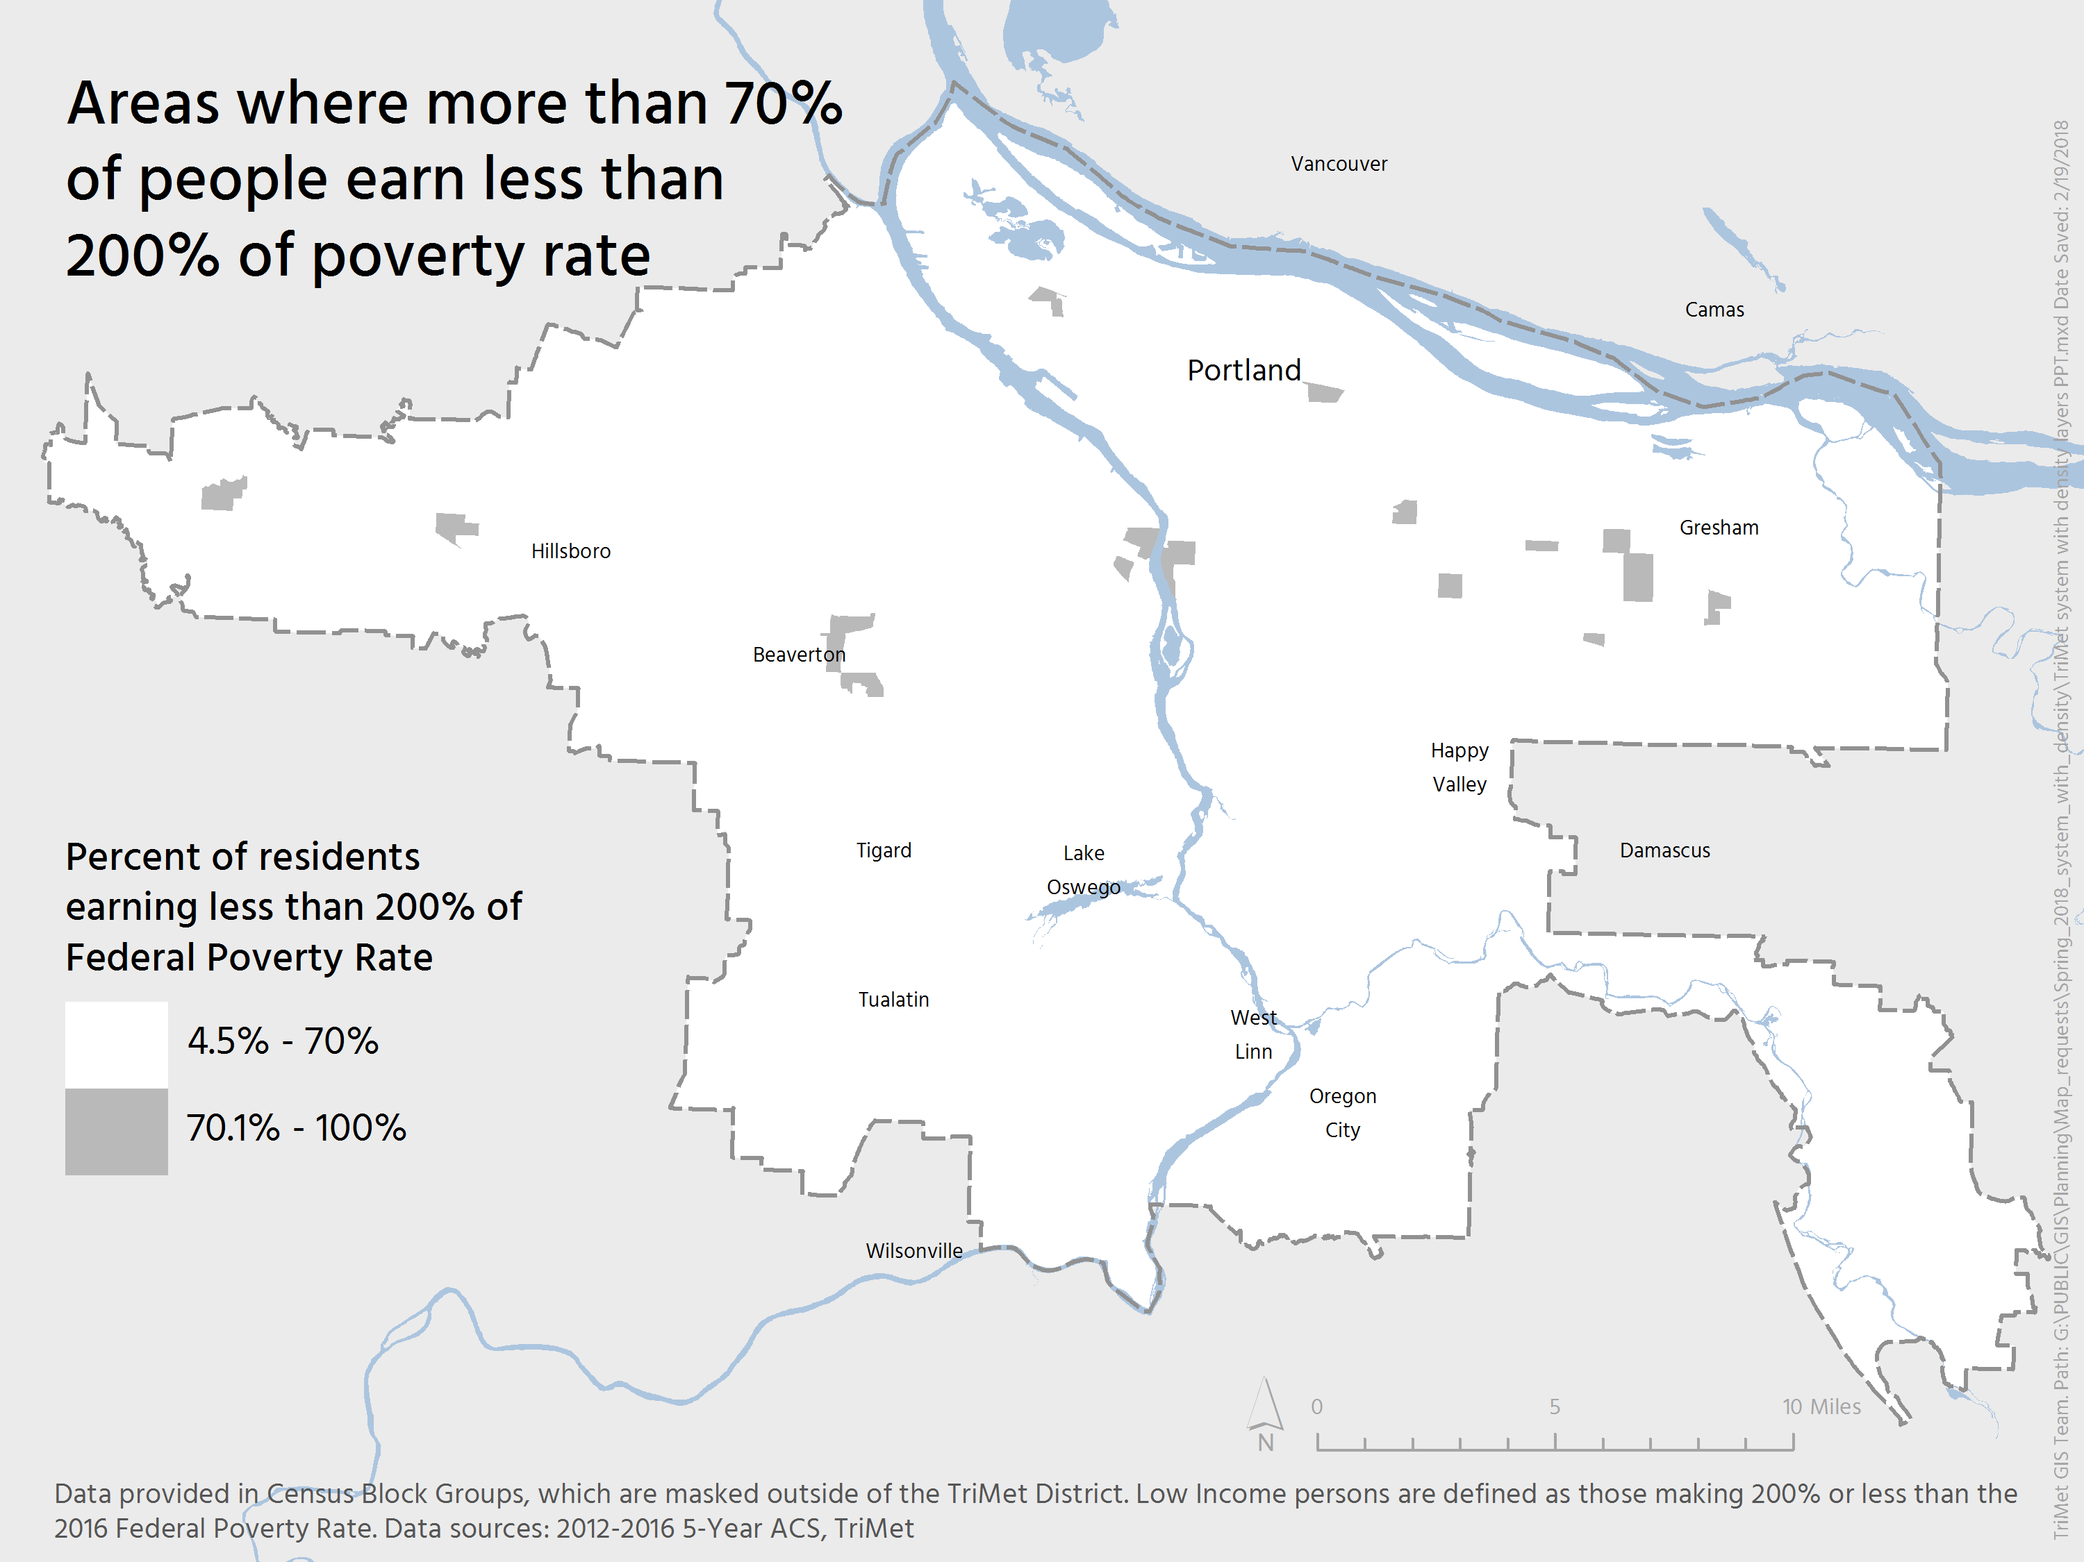

Slide 6
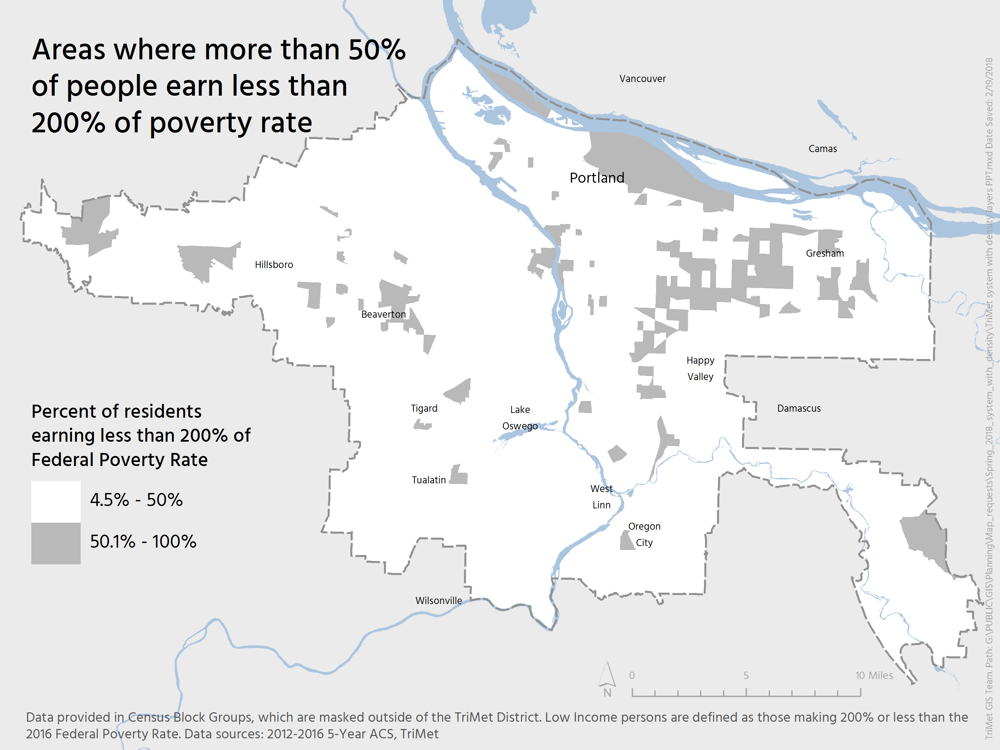

Slide 7
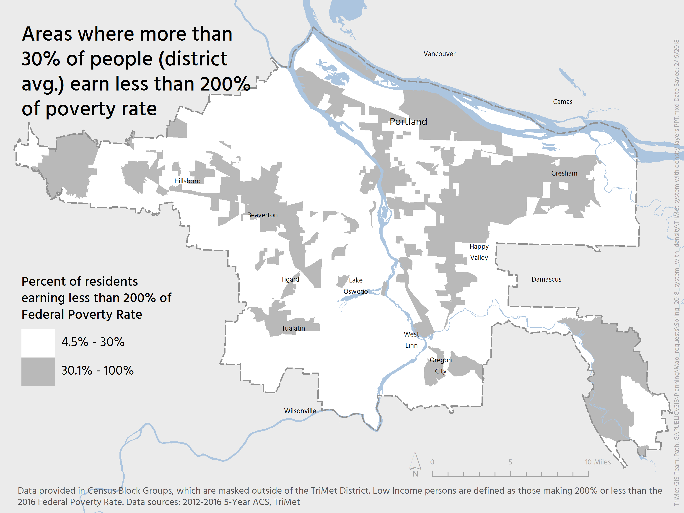

Slide 8
High Percentage Poverty
✓
Staff Recommendation:
  An area with a high percentage of poverty has 30% (district average) or more of its people earning less than 200% of FPL

Slide 9
FY19 Service Proposal
24 hour service on lines 20-Burnside/Stark and 57-TV Hwy. New bus service to the Portland Airport when Red Line isn’t running
Increased frequency on 3 bus lines (20,73-122nd,81-Kane Rd/257th)
Route change to 2 bus lines (24-Fremont,79-Clackamas/Oregon City)
Increased span of service (61-Marquam Hill/Beaverton,64-Marquam Hill/Tigard,66-Marquam Hill/Hollywood,68-Marquam Hill/Collins Circle, 96-Tualatin/I-5)
One new bus line (Clackamas County on Webster Road)

Slide 10
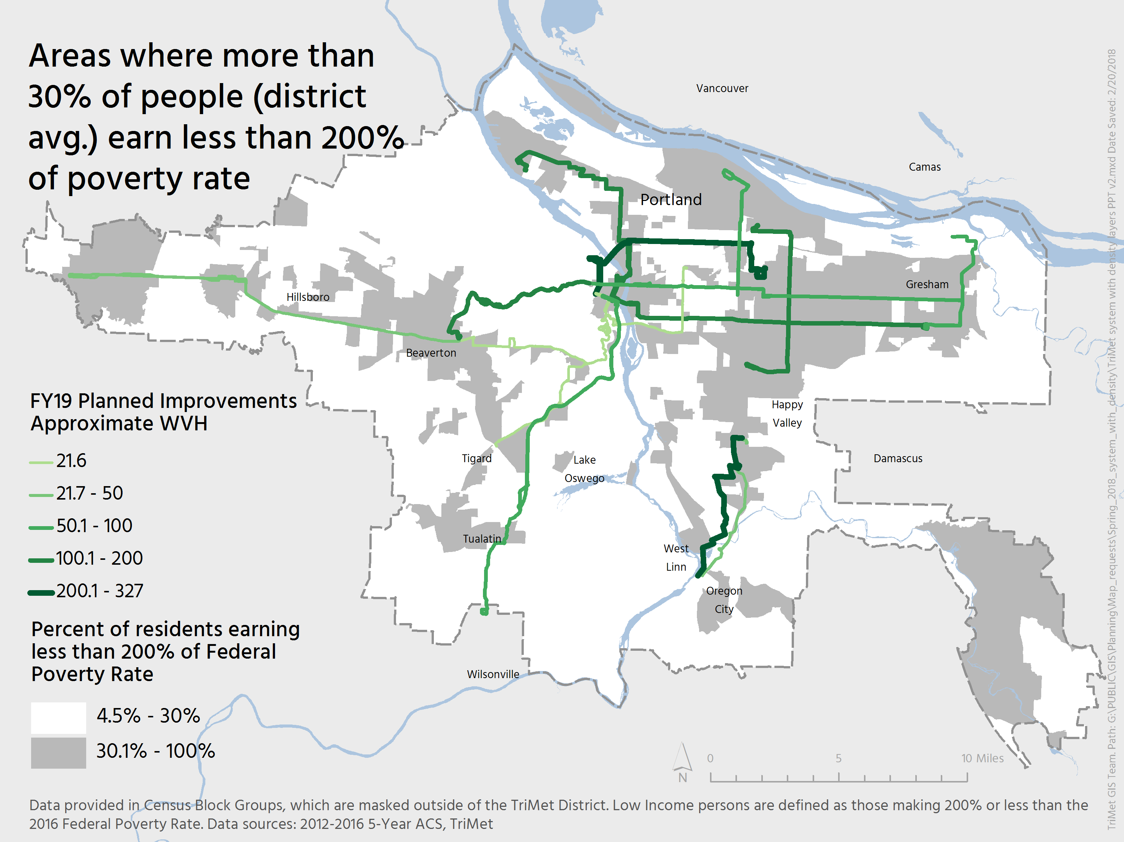
Notes:
58% of the FY19 weekly service hours serve block groups with above average poverty (i.e., block groups where more than 30% of the residents earn less than 200% of the federal poverty rate).

Slide 11
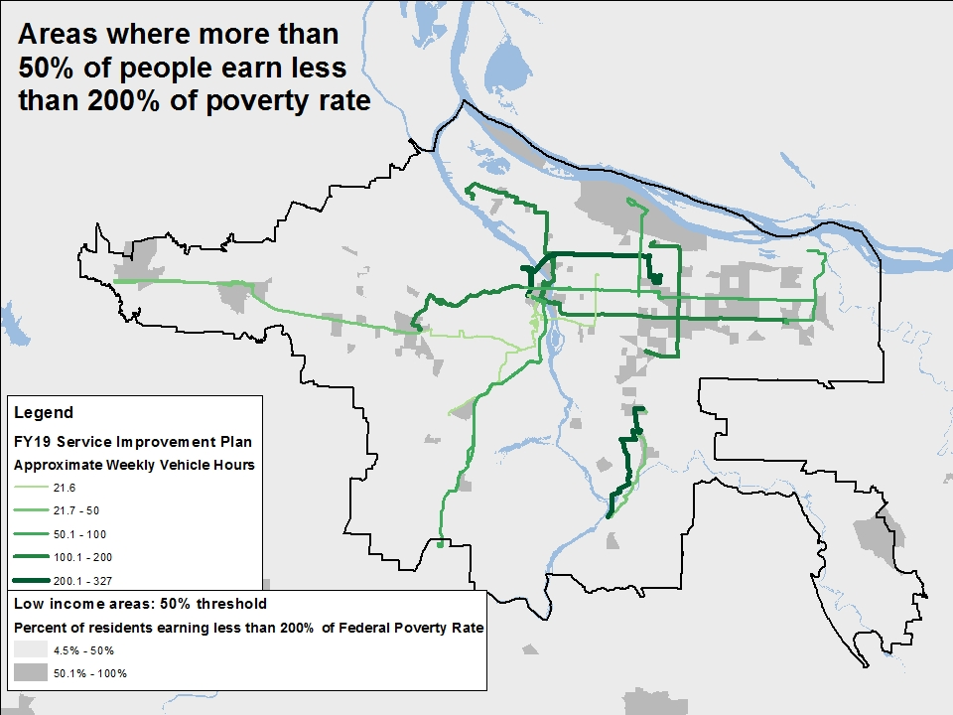

Slide 12
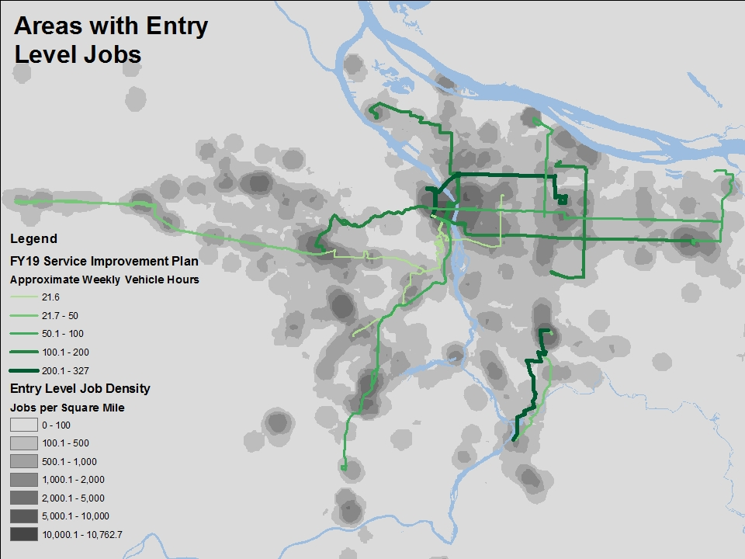

Slide 13
Funding Sources
Source | Amount
Employer Payroll Tax Increase | $4 mil
HB2017 | $4 mil

Slide 14
HB2017 Funding Allocation
$55 mil
Low Income Fare
$12 mil (22%)
Low Income Fare
$12m (24%)
Low Income Fare (18%)
Remaining HB2017
Funds $39 mil (71%)
Remaining HB2017 Funds
$34.5m (69%)
FY19 Service
Proposal $4 mil
(7%)
Remaining HB2017 Funds (69%)
FY19 Service
Proposal $3.5m
(7%)
FY19 Service
Proposal (13%)

Slide 15
Planning Process
Budget
Forecast
Roll Out Service Changes
Annual Service Plan Development
TriMet Board Action
Community
Input
Annual Service Plan Proposal
Public Comment, Round #2
Title VI Review
Revise Annual Service Plan
Public Comment, TEAC & CAT Review

Slide 16
FY19 Service Proposal Outreach
Online outreach (+2,000 comments)
  Email blast
  Riders Club
  Social Media
Onboard outreach
7 open house meetings (1 focused on the Spanish speaking community)
Letters to businesses and residences within ¼ mile of proposed new lines and route changes
2nd round of outreach ongoing (including an 8th open house meeting)

Slide 17
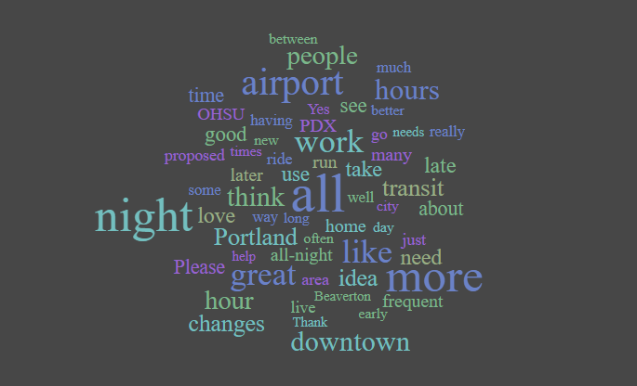
FY19 Service Proposal Comments, Round #1
Low Income Fare
$12m (24%)
Remaining HB2017 Funds
$34.5m (69%)
FY19 Service
Proposal $3.5m
(7%)

Slide 18
✓

Slide 19
Regional Coordination/Non-TriMet Services
Non-TriMet service from outside the district that reduces fragmentation of service between the communities inside and outside the TriMet district
Last mile service to difficult to serve areas on the edge of the district due to:
  Street network
  Low population or employment density

Slide 20
Regional Coordination/Non-TriMet Services
Inside/Outside TriMet Connection: Reduce Fragmentation
(Mix of county/TriMet HB2017 funds)
Last Mile Shuttle (TriMet HB2017 funds)
TriMet Network
Outside TriMet District
Inside TriMet District

Slide 21
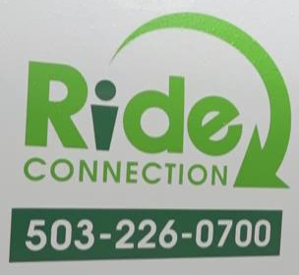
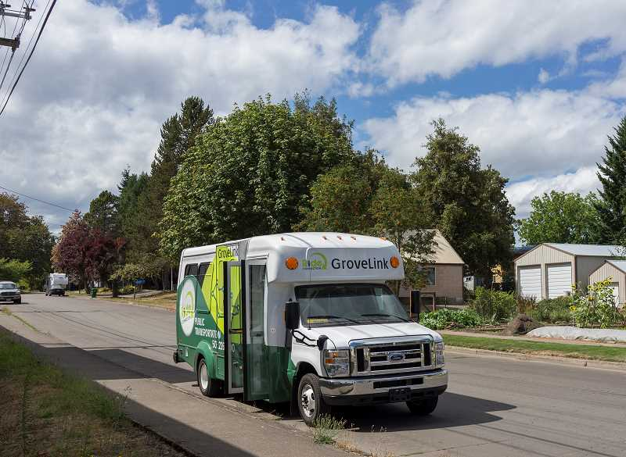
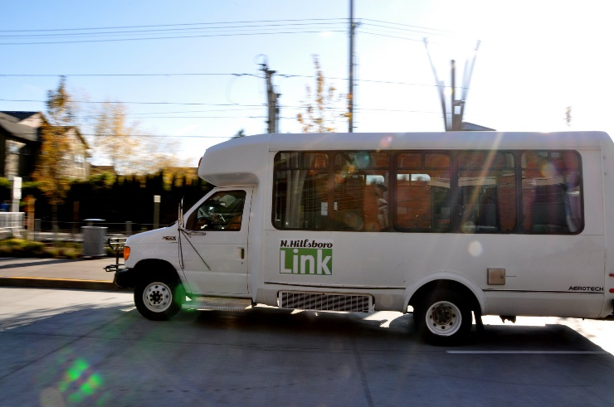
Regional Coordination/Non-TriMet Services
Existing last mile shuttles:
GroveLink – Forest Grove
N. Hillsboro Shuttle – North Hillsboro Industrial Area
Tualatin Shuttle – Tualatin Industrial Area
PCC – late night shuttle to Swan Island

Slide 22
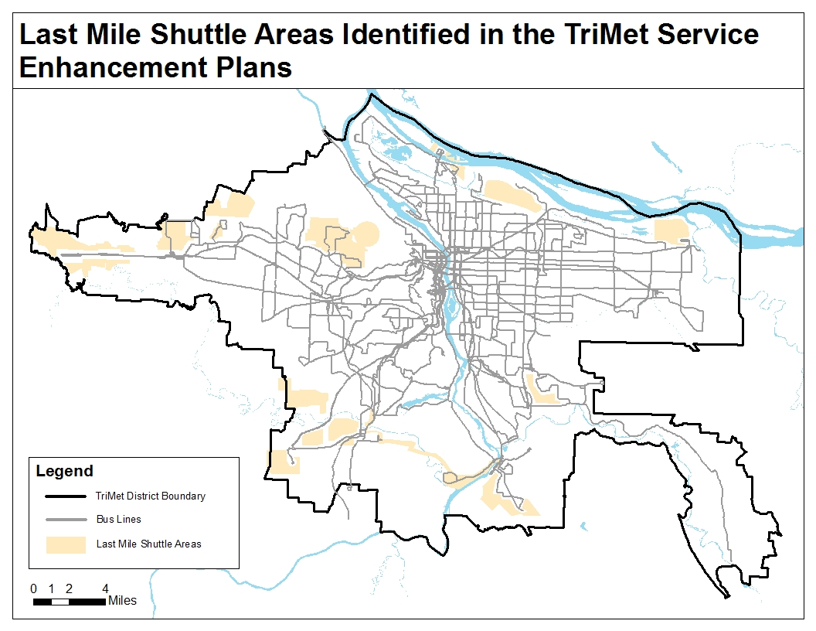

Slide 23


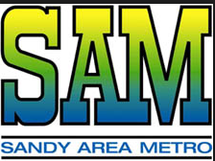

Regional Coordination/Non-TriMet Services
Public transit connecting with TriMet:
Clackamas County providers
  SMART
  Sandy Area Metro
  Canby Area Transit
  South Clackamas Transit District
New rural to urban connections

Slide 24
Regional Coordination/Non-TriMet Services
✓
Staff recommendation
  Set aside $3 mil for Regional Coordination/Non-TriMet Services
  Review at the end of the process

Slide 25
✓
HB2017 Funding Allocation
$55 mil
$55 mil
Low Income Fare
$12m (24%)
Low Income Fare
$12 mil (22%)
Remaining HB2017 Funds
$32.5m (65%)
FY19 Service
Proposal $4 mil
(7%)
Remaining HB2017
Funds $37 mil (67%)
FY19 Service
Proposal $3.5m
(7%)
Regional
Coordination
$3m (5.5%)

Slide 26
Next Meeting: Mar. 23rd
Dependencies for new service (mechanics, buses, garages, etc.)
Maximum “ramp up” of new service
Other investments:
  Electric Bus
  Articulated Bus
  System Capital
  Enhanced Transit
Upcoming Public Workshops

Slide 27
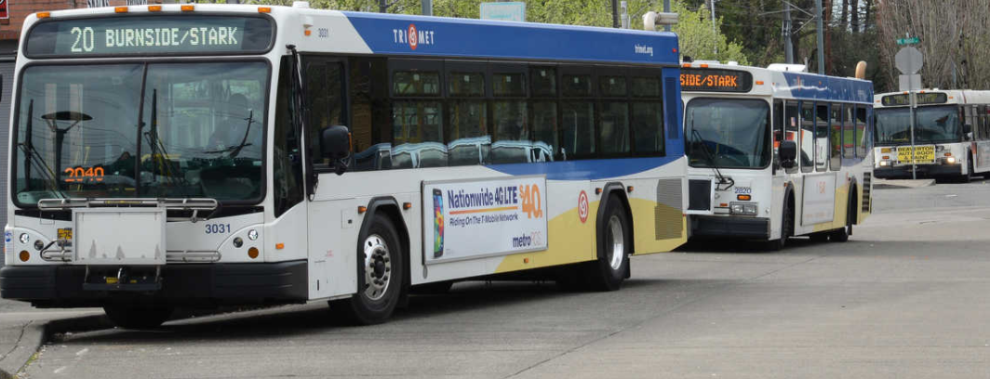
Public Comment

